Slide 1
Computer Vision and Image Processing
Tirgul 4
Quantization
By Shai Aharon & Moriya Bitton

Slide 2
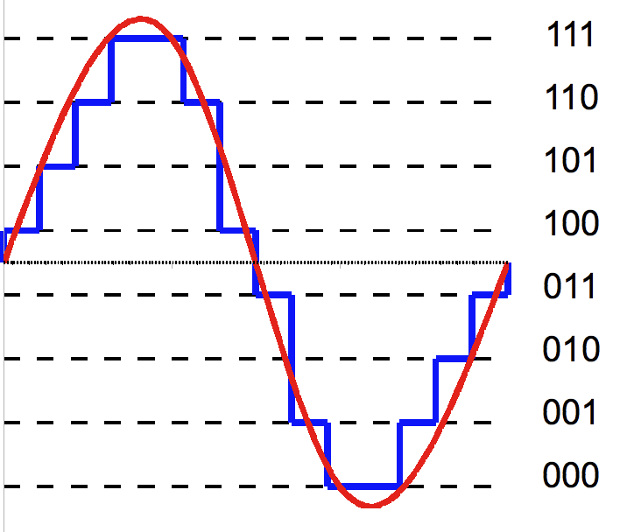
What is ‘Quantization’?
Wiki:
Quantization is the process of constraining an input from a continuous or
otherwise large set of values (such as the real numbers)
to a discrete set (such as the integers)

Slide 3
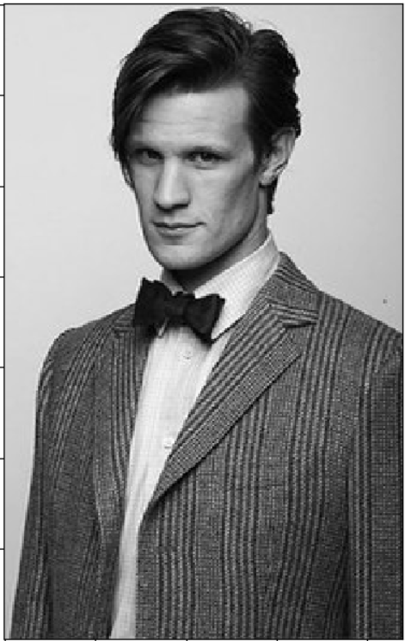
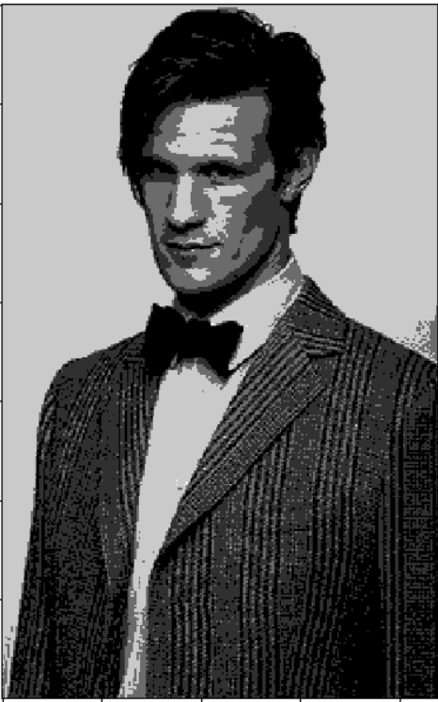
Quantization in an image
255 colors
4 colors

Slide 4
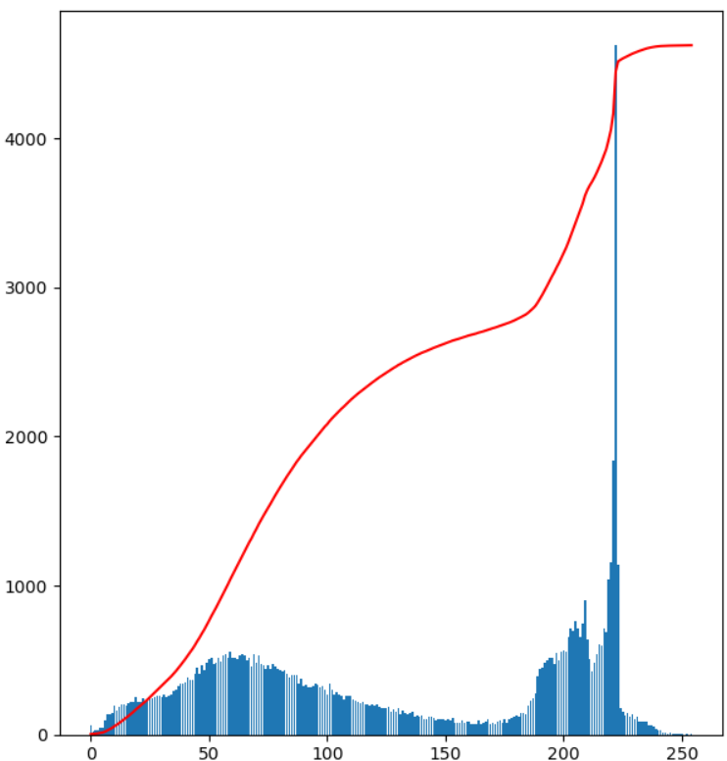
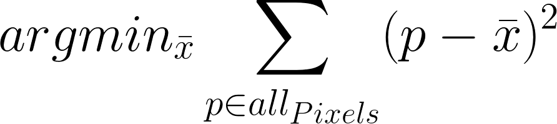
How?
We start with the image histogram
The goal is to find the k colors which are closest to the other colors (k-Means*)
If we want to quantize the image to one color, will need to find the mean color

Slide 5
How?
We start with the image histogram
The goal is to find the k colors which are closest to the other colors (k-Means*)
If we want to quantize the image to one color, will need to find the mean color
?

Slide 6
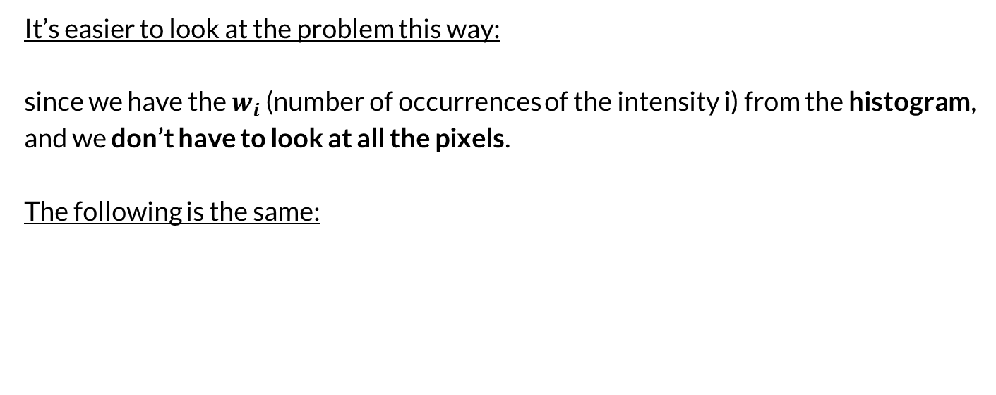
Equation in details
It’s easier to look at the problem this way:
since we have the $w_{i}$ (number of occurrences of the intensity i) from the histogram, and we don’t have to look at all the pixels.
The following is the same:

Slide 7
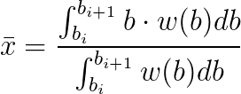
Weighted Mean
To find the color to minimize
We’ll use ‘Weighted Mean’:
def getWeightedMean_simple(intens: np.ndarray, cell_values: np.ndarray) -> int:
val = 0
for i in range(len(intens)):
val += intens[i] * cell_values[i]
return val / cell_values.sum()
DON’T DO THIS!!

Slide 8
Expand to k grayscales
For one color, we had two boundaries, lower=0 and upper=255
How much for k colors?

Slide 9
Expand to k grayscales
For one color, we had two boundaries, lower=0 and upper=255
How much for k colors? K+1!
Lets say k=4:
We’ll spread them evenly
And compute the mean for each ‘cell’

Slide 10
Expand to k grayscales
For one color, we had two boundaries, lower=0 and upper=255
How much for k colors? K+1!
Lets say k=4:
We’ll spread them evenly
And compute the mean for each ‘cell’

Slide 11

Expand to k grayscales
Now the boundaries, don’t represent the cells very well, they can be too close to their mean.
So we need to adjust the boundaries:
We’ll move each boundary to be in the middle of two means

Slide 12
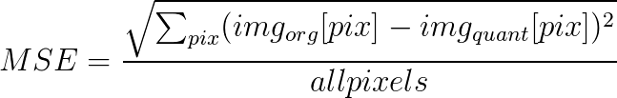
Endnotes
Since this isn’t a closed solution, it forces us to do the above multiple times
Ether a fix amount of times, of until the error (MSE) stops changing
How to check the error?
This can be written in one line in python!
I don’t want to see any loops!

Slide 13
Conclusion
Histogram
Goal:
K+1 boundaries (lower=0, upper=255, and the other k-1 spread evenly)
For each ‘cell’: compute the mean
For each boundary (except the lower and upper): adjust the boundary the middle of two means
Repete to level 2 until the error (MSE) stops changing

